Slide 1


Slide 2
AR is the future.
“..it’s for everyone. I think AR is that big, it’s huge. I get excited because of the things that could be done that could improve a lot of lives. And be entertaining.”
Tim Cook, Feb 2017
”..we’re bringing augmented reality to everyone, by opening up a developer platform so that people can build AR features for the cameras that live inside Facebook, Instagram, Messenger and Whatsapp.”
Mark Zuckerberg, F8, April 2017

Slide 3
This is where AiR comes in.

Slide 4
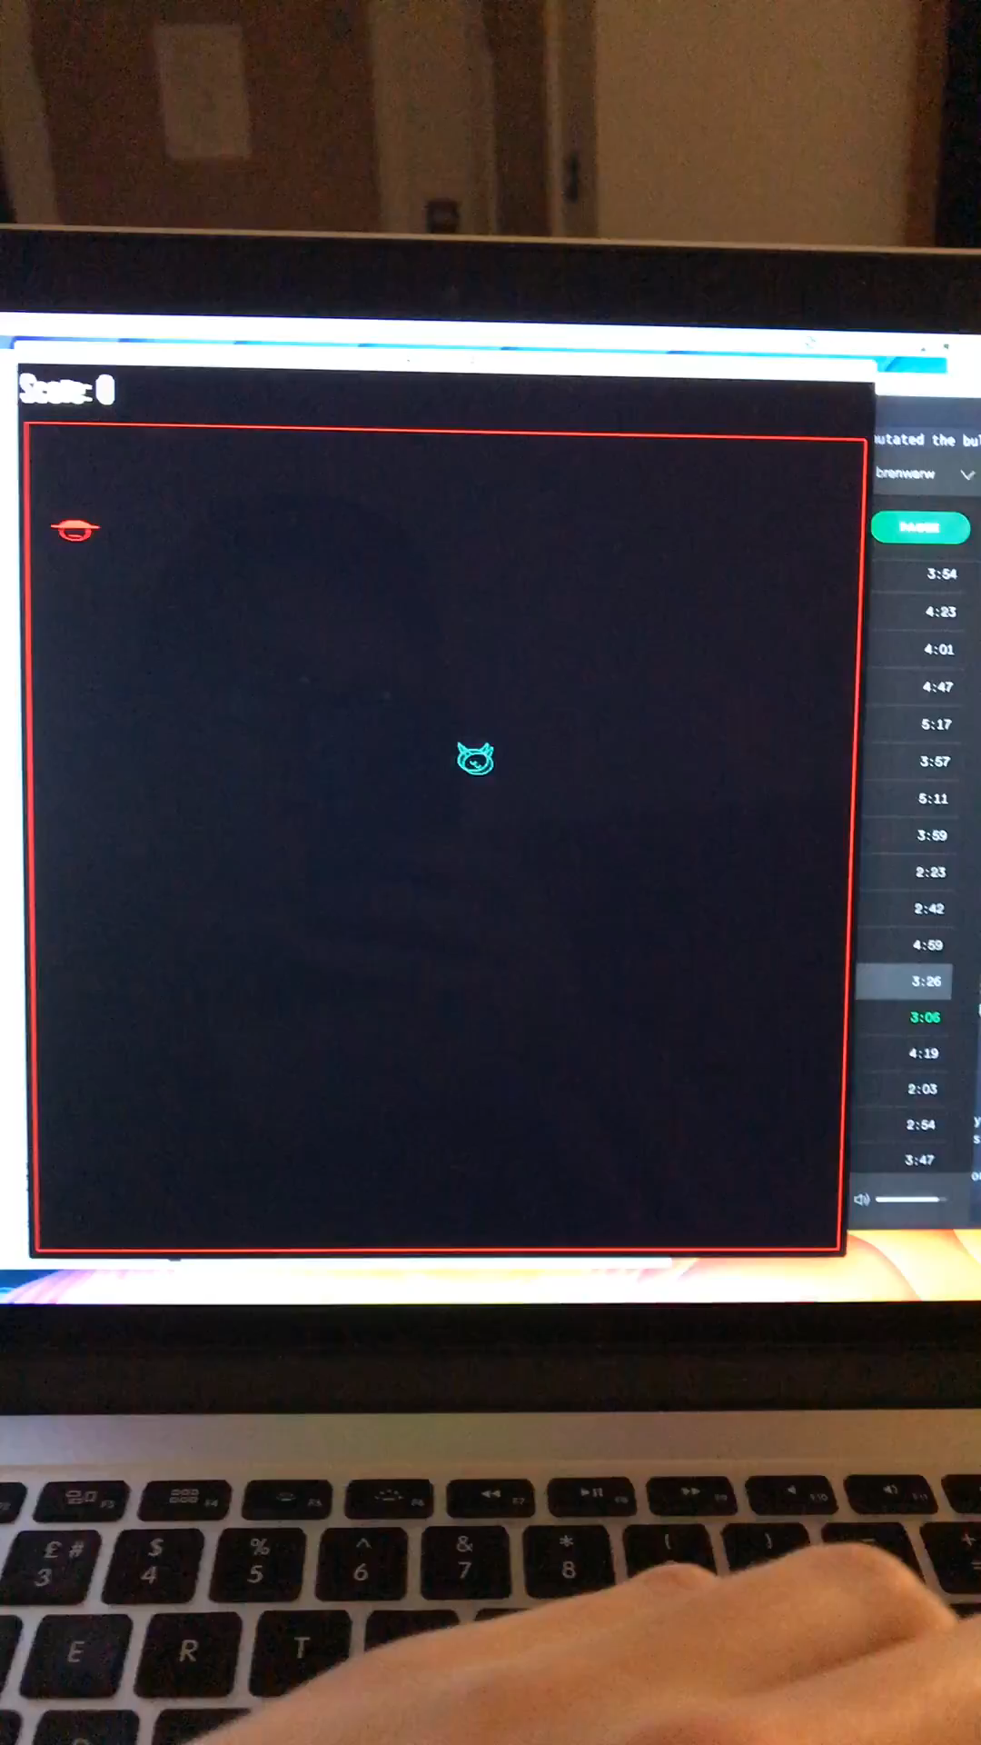
Video her

Slide 5
What’s next?
Feature
Feature
Feature
Feature

Slide 6
How it works
Users tell AiR what flights they are taking, and on what day, and AiR constructs their route.
AiR builds the route using Sentinel 2 imagery and linked data to provide interesting information
AiR is fun and educational, showing key landmarks, populations and more

Slide 7
Competitors
AiR isn’t against the grain, it goes with it.

Slide 8
Go-to Market Proposition
Alpha Version
Beta
Market

Slide 9
Commercial Roadmap
Cap data limits so users pay to see more
“Info Pack” DLCs can be purchased
Social Media

